Slide 1

SUB CODE: CS6110
SUB NAME: OBJECT ORIENTED ANALYSIS AND DESIGN
PACMAN GAME
KARTIKEYAN T.R SURIYAA V GURU RAMAN C
2020503520 2020503550 2020503510

Slide 2

DOMAIN
GAME DESIGN

Slide 3
^{PROBLEM STATEMENT}
Designing a game pacman to be played by one player where a player can sit and get engaged physically and mentally. Making various modifications to the game UI such as game theme and player avatar and the game maze

Slide 4
OBJECTIVES:
To create a game using OOPS concepts
Analyze various game algorithms
To understand OOAD concepts better
To create an interactive GUI
To implement proper software design methodologies [70% design and 30% implementation]

Slide 5
DESCRIPTION:
Pac-Man is an action maze chase video game, the player controls the eponymous character through an enclosed maze. The objective of the game is to eat all of the dots placed in the maze while avoiding four colored ghosts.

Slide 6
PACMAN GAME
USE CASE DIAGRAM

Slide 7
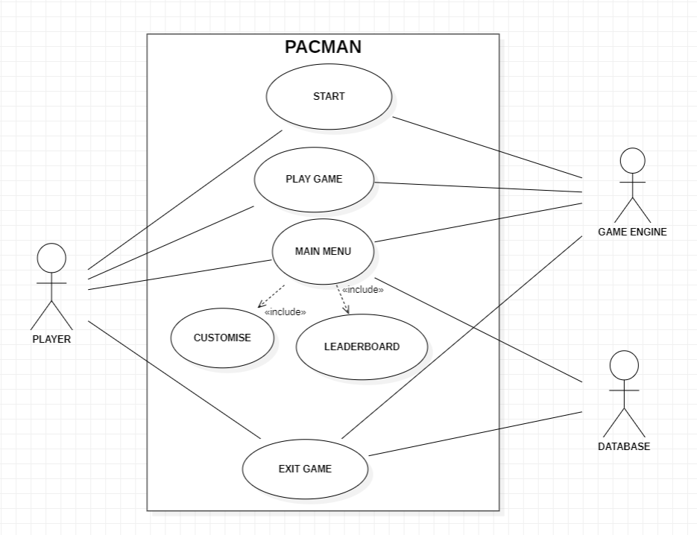

Slide 8
PACMAN GAME
DOMAIN MODEL

Slide 9
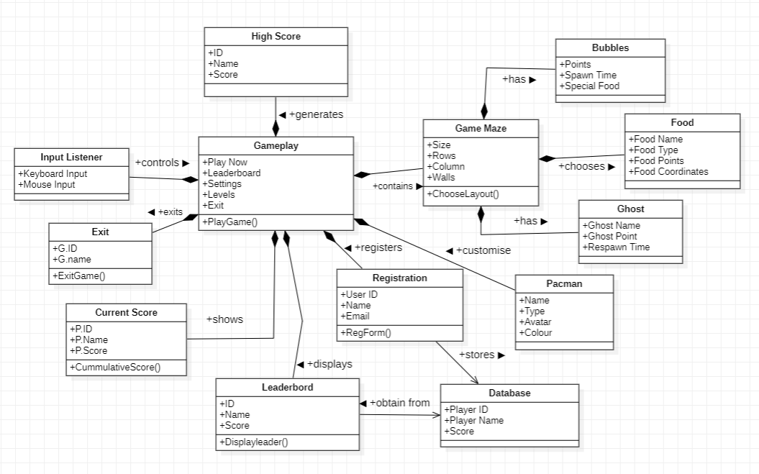

Slide 10
PACMAN GAME
SEQUENCE DIAGRAM

Slide 11
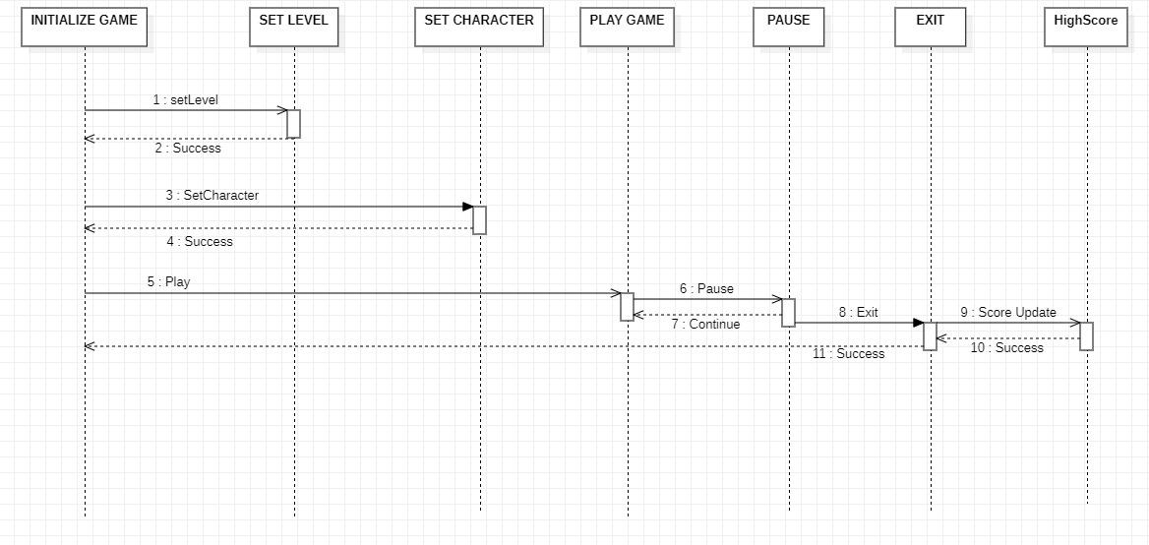

Slide 12
PACMAN GAME
ACTIVITY DIAGRAM

Slide 13
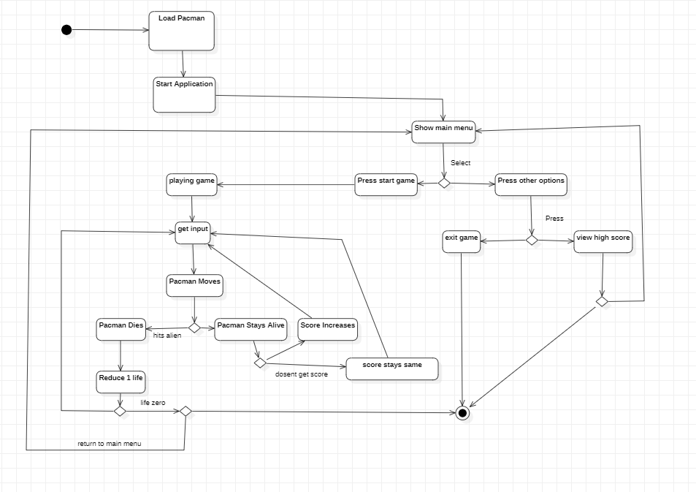
Hits

Slide 14
PACMAN GAME
STATE DIAGRAM

Slide 15
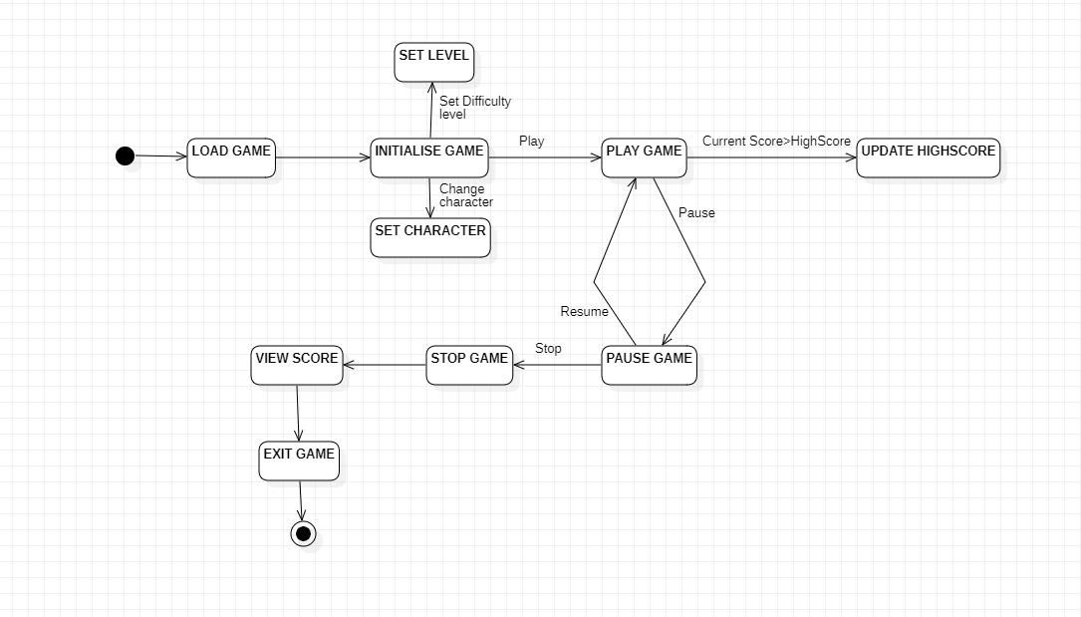

Slide 16
PACMAN GAME
COMMUNICATION DIAGRAM

Slide 17
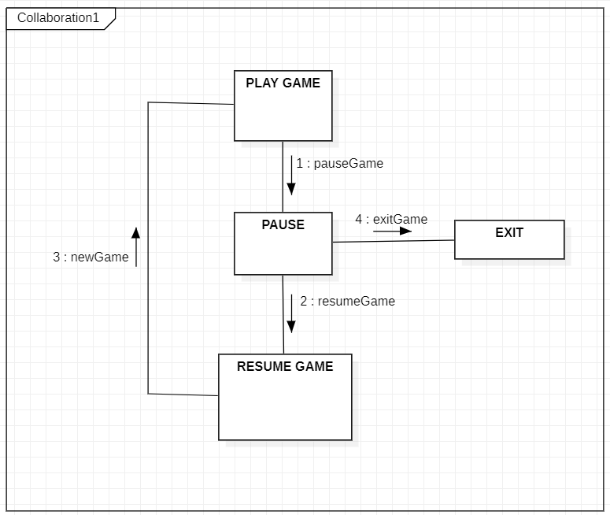

Slide 18
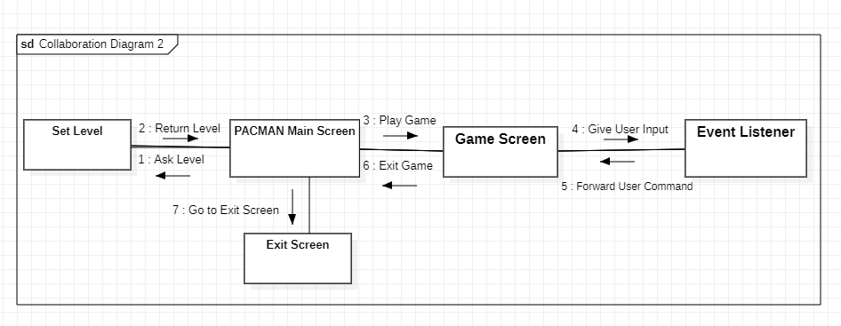

Slide 19
PACMAN GAME
COMPONENT
DIAGRAM

Slide 20
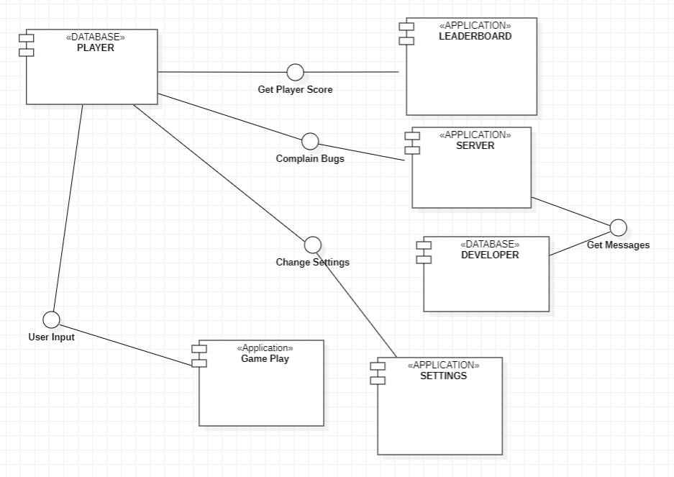

Slide 21
PACMAN GAME
PACKAGE DIAGRAM

Slide 22
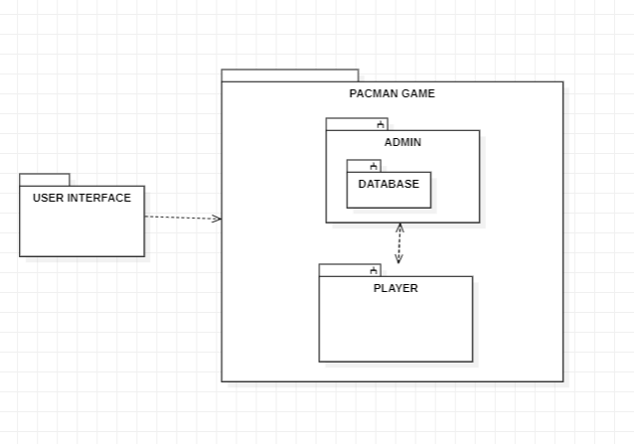

Slide 23
PACMAN GAME
DEPLOYMENT DIAGRAM

Slide 24
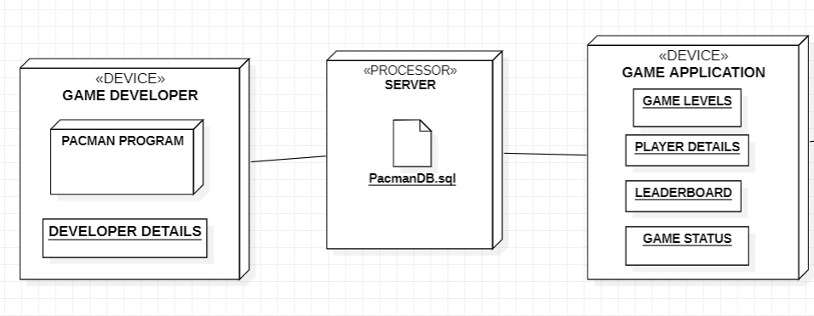
UDP
UDP

Slide 25
THANK YOU!!

